Slide 1
Healthkeeper Medication Timer and Tracker
Week 3 Presentation
Abbas Dargahi, Isaac Hodge

Slide 2
Introduction
HealthKeeper
A program for medication tracking and reminders
Designed for those who take prescriptions and need help keeping track of them
Current Progress
Some Progress has been made to the frontend of the project
Considerable progress has been made to the backend

Slide 3
Frontend
HTML and CSS were used for all of the front end code
The HTML code is accessed through the PHP file that pulls from the server
All of this code was created locally through Notepad++
Using HTML and CSS is a classic combo that works to make stylizing a website simple to implement and accessible for back-end functionality.

Slide 4
Backend
PHP files and coding allow for dynamic website
PHP pulls data automatically and can insert new data
Possible due to Apache web server
Apache, MySQL, and PHP have given us all the functionality needed to create a dynamic website.

Slide 5
Login & Logout
Log into a pre-existing account
Login allows for users to access their own medication data
Logout completely exits the account (cannot back-arrow)

Slide 6
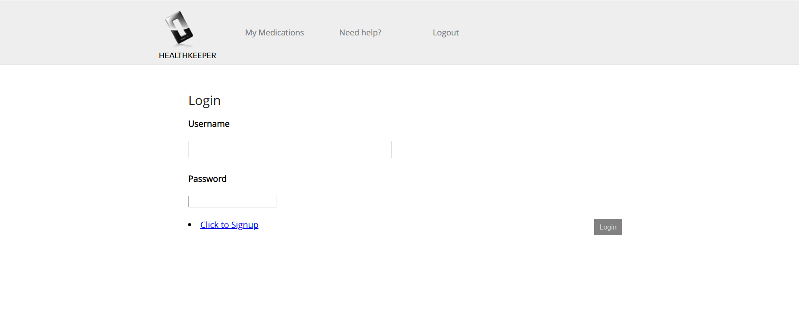

Slide 7
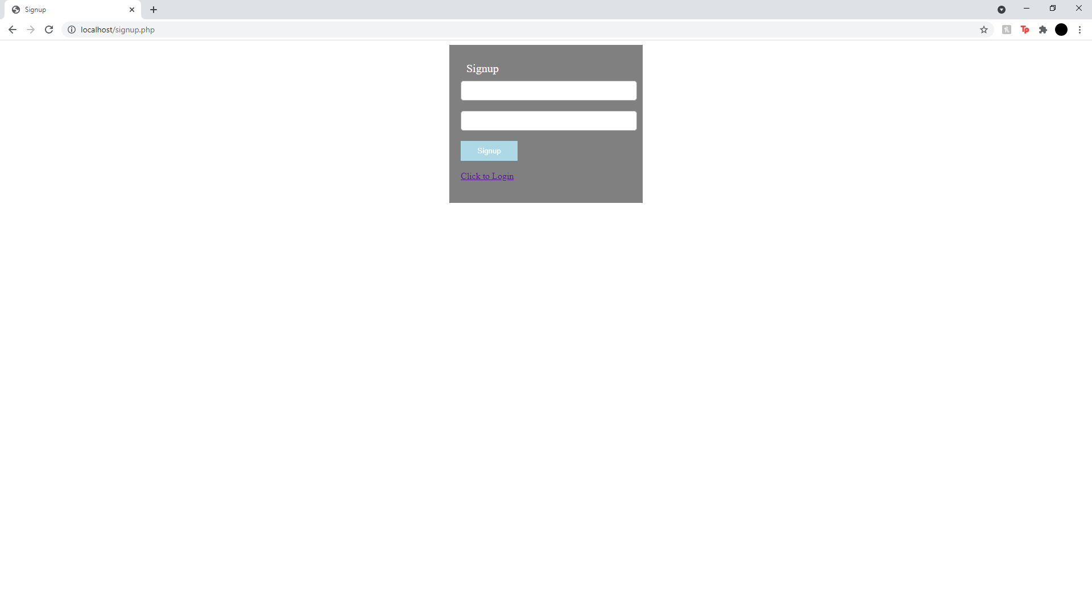
Signup Page
Similar look to Login
Allows new user to create an account and have it stored into the database
Once created, the user is directed back to the login screen

Slide 8
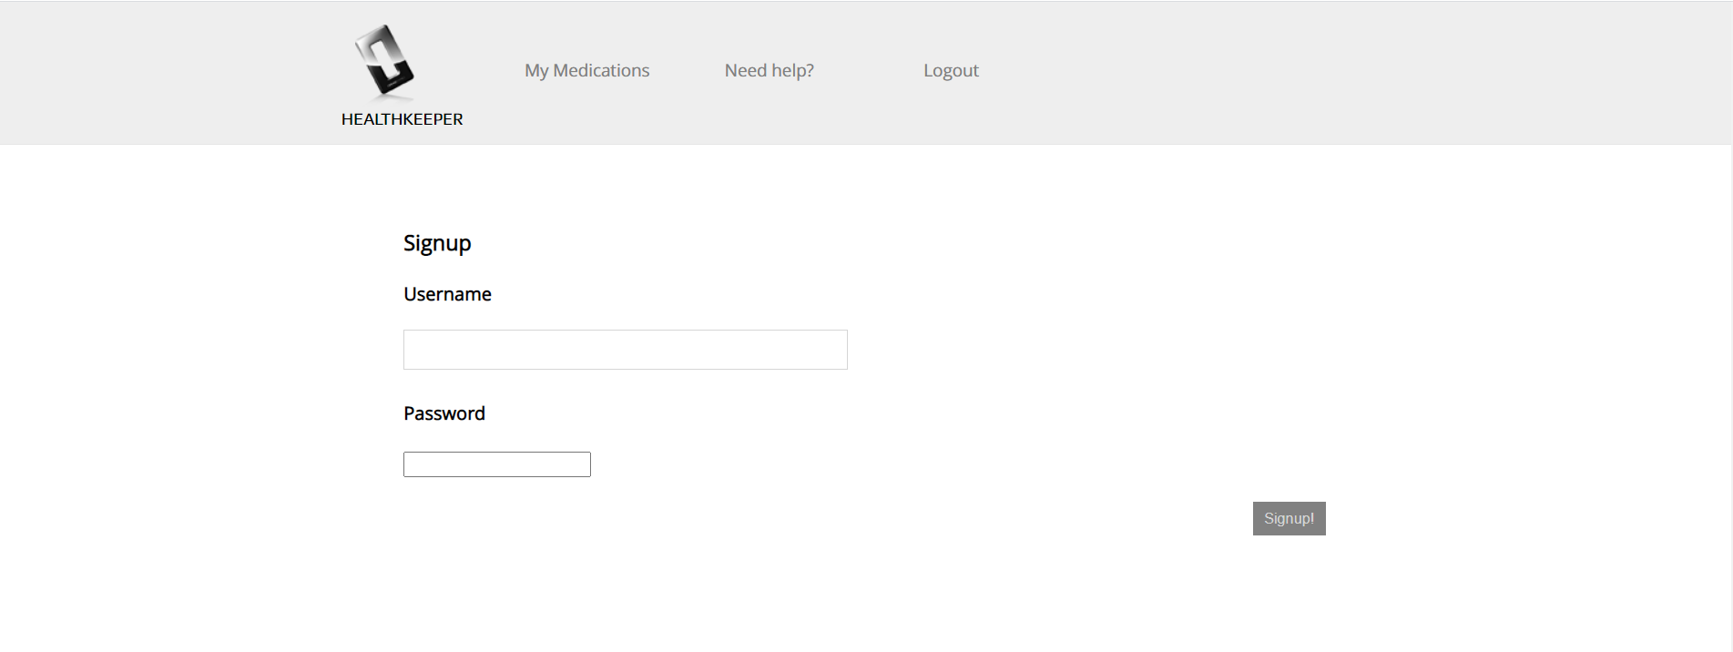

Slide 9
Milestone
Completed
Further frontend designing and styling
Manage Medications tab removed
Database functionality nearly fully implemented
Website can directly interact with server and database
Signup functional
Login functional, stores personal data
Logout fully working
Data displayed specific to individual accounts
To Do
Finish html design and css style
Add button functionality
Create delete button + functionality
“Need Help?” tab functionality
(Pop-up alerts for upcoming prescriptions)
(Update “next dose” automatically)
() -Hope to accomplish

